Slide 1
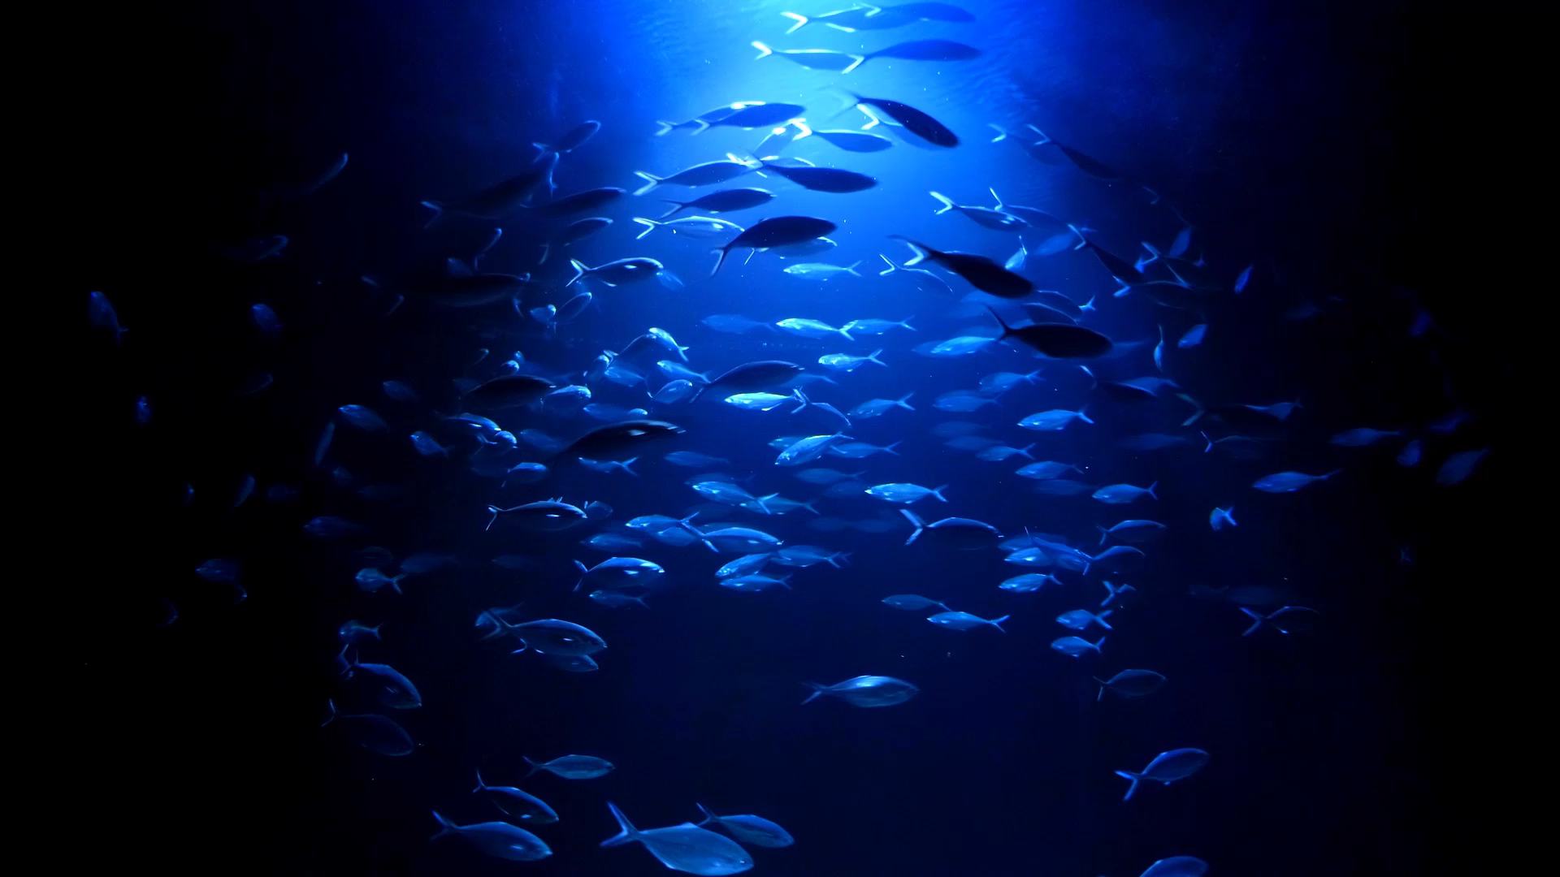
Fish detection from ROV images using Yolov8
Federico staffolani
Enrico maria sardellini

Slide 2
Table of contents
01
02
03
04
05
06
Introduction
State of art
Dataset
Project goal and ROV images challenges
Current state of deep learning fish detection
Materials provided and preprocessing work
Methodology
Results
Conclusions
Architecture, hyperparameters and model choice
Metrics comparison and inference
Lessons learned and future work suggestions

Slide 3

01
Introduction
Project goal and ROV images challenges

Slide 4
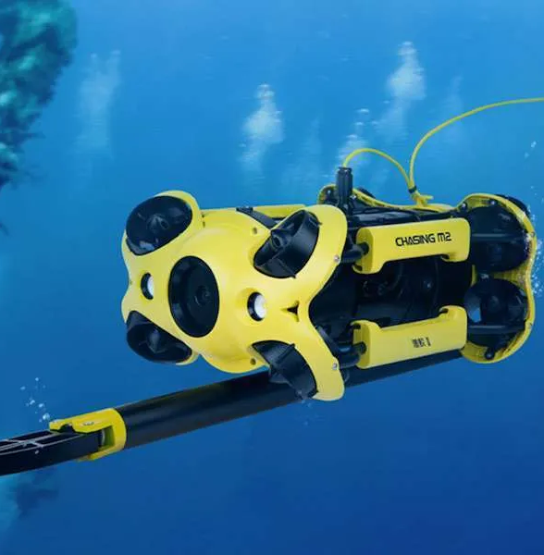
What is a ROV and why use it?
ROVs are remote-controlled vehicles used to monitor the ocean because they can go where divers can’t
The International Marine Contractors Association (IMCA) recognises five classes of ROVs
First class ROVs, the type that provided images for our study, are small, fully electric, camera-equipped, can reach a maximum depth of 300m and have a lifting capacity of up to 10kg
They can capture images and data around offshore installations, helping to to observe and document marine life

Slide 5

Project goal
ENI needs a tool to detect fish from ROV images to understand the impact of offshore structures in the ecosystem and decide on their removal
Challenges
Species variability
Envirnonment
Annotations
Different colors, shapes and positions. Many small fish in the background and low image quality
Different water conditions and depth, presence of plants or platform elements.
Necessary manual revision of annotations for almost all images. This is time-consuming and error-prone.

Slide 6
Our proposed pipeline in brief:
1) Dataset Analysis and Preprocessing
2) Dataset Split
4) Model Selection
5) Model Testing with inferences
3) Model Training

Slide 7
02
State of art
Current state of deep learning fish detection

Slide 8
DL tecnologies for fish detection
What's new in our work?
We trained on YOLOv8, an advanced one-stage architecture. It’s anchor-free and has multi-scale features to improve model performance and compatibility with real-time operations.
1
Two stage
State of art works:
High accuracy
Low processing speed, problematic in ROV images
Li et al. (2015): Fast and Faster R-CNN, open datasets, low resolution and unrepresentative clipping limitations.
Al Muksit et al. (2022): new datasets with high-definition images. Developed two new YOLO-Fish models based on YOLOv3.
Connolly et al. (2022): adapted automated detection frameworks for ROV videos in shallow waters, with YOLOv5 and Detectron.
2
One stage
High speed
More problems with class imbalance and misclassifications

Slide 9
03
Dataset
Materials provided and preprocessing work

Slide 10
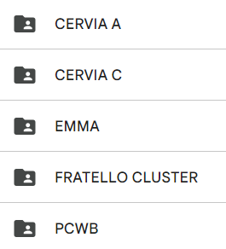
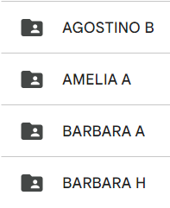
Initial material provided
9 folders, one for each ROV, totalling around 4000 images.
The information content was heterogeneous for various reasons:
presence of images without annotations
semantic differences on the labels applied to the fish
annotations often point-like and not rectangular
Dataset List

Slide 11
Preprocessing workflow
Removing empty images
Replacing all labels with ‘fish’
Bounding box manual adjustment with Roboflow
Removing images with shoals of unlabelled fish
Point annotation conversion with bounding box size 20x20

Slide 12
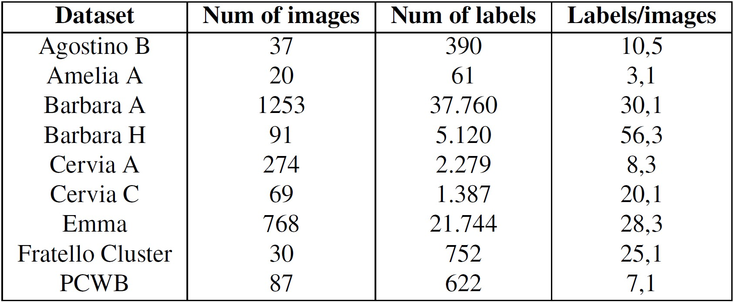
Dataset structure after preprocessing
Number of images, labels and ratio between them

Slide 13
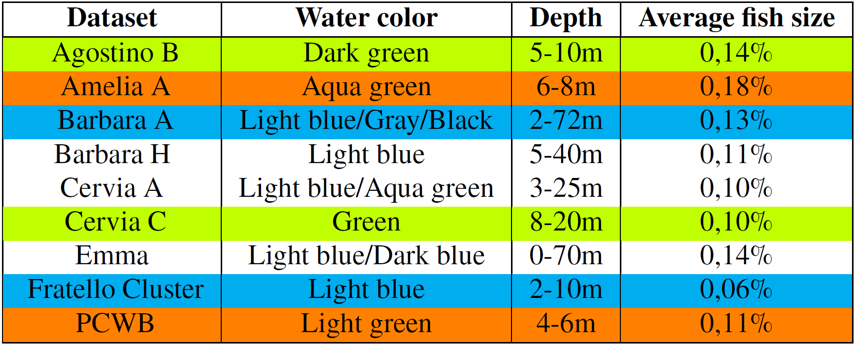
Dataset merge
Merged:
Agostino B – Cervia C
Fratello Cluster – Barbara A
PCWB – Amelia A
Single:
Cervia A
Emma
Barbara H
Environmental characteristics and average size of fish as a percentage of the total image in datasets

Slide 14
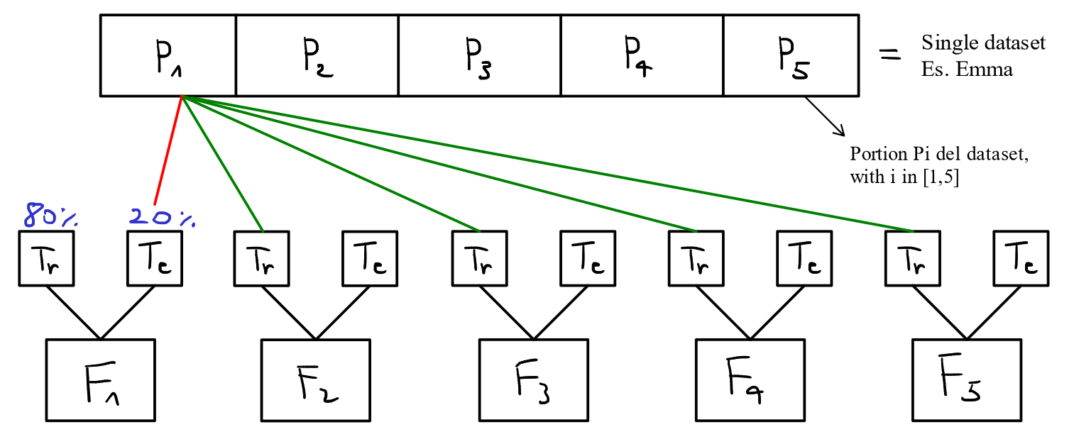
Dataset split
Input: the 6 datasets
Each is divided into 5 parts
Each is assigned by numbering to a specific fold
Output: 5 folds (for k fold cross validation)
Summary of the splitting process

Slide 15
04
Methodology
Architecture, hyperparameters and model choice

Slide 16
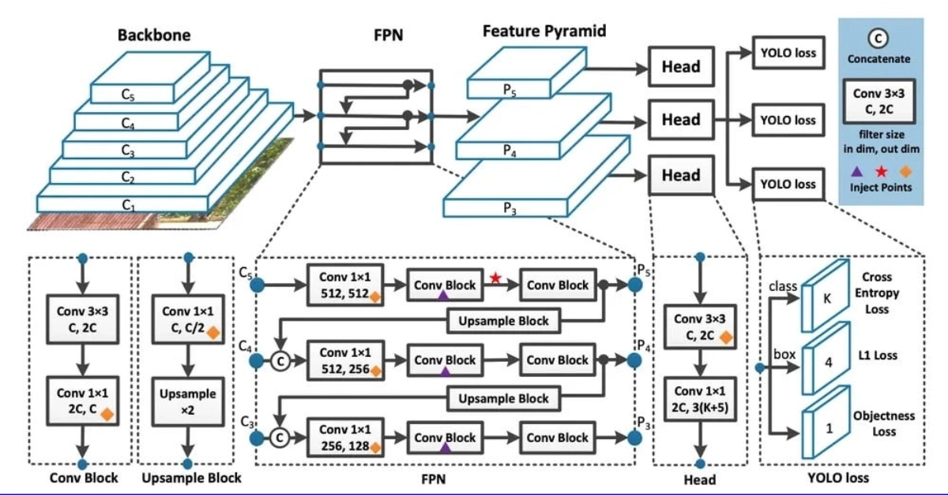
Architecture: YOLOv8
Neck

Slide 17

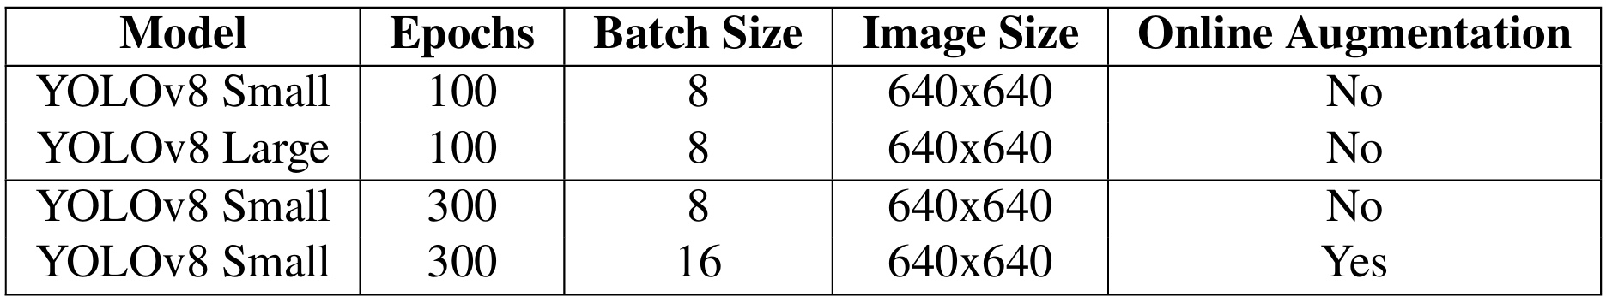
Hyperparameter settings
Training method: k fold cross validation (k = 5) using dataset splits
Use of Docker containers with 2 GPU
Optimizer: Adam
Summary of Hyperparameters

Slide 18
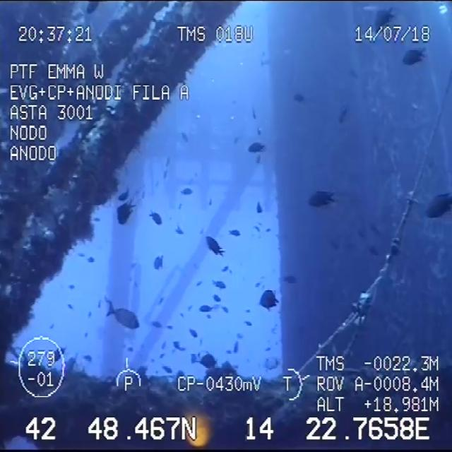
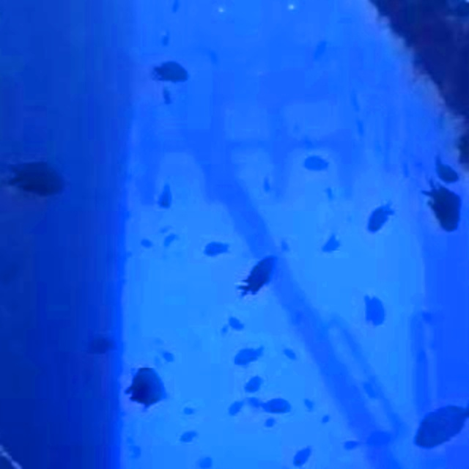
Augmentation example
Brightness (+/- 40%)
Scaling (+/- 50%)
Horizontal flip (50%)
Saturation (+/- 40%)
Original
Augmented

Slide 19
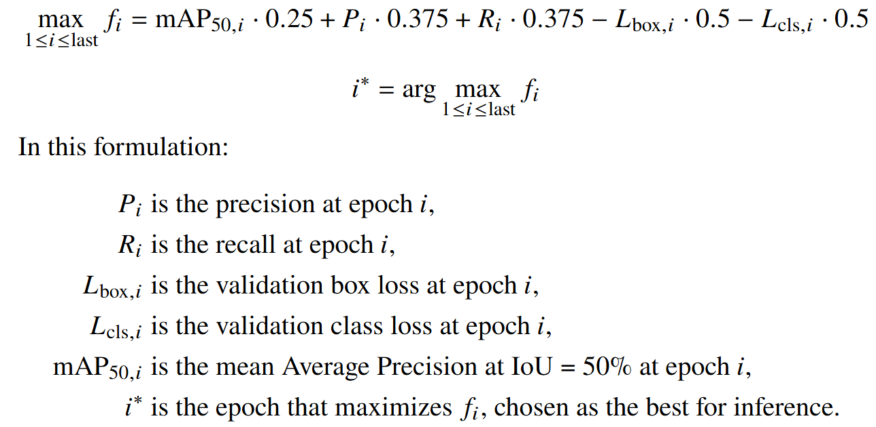
Model choice
Customised fitness function for weighing losses
Usually finds a better epoch than the default one in this dataset
Customized function for the best epoch

Slide 20
05
Results
Metrics comparison and inference

Slide 21
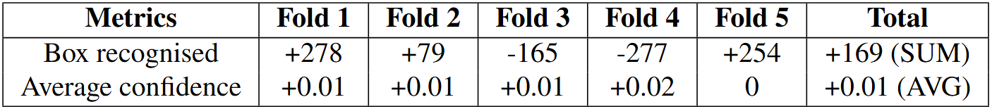
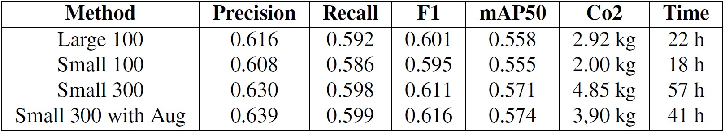
Table of results
Measurement of inference differences with threshold of 0.6 on Small 300
Average, for each method, of best model maximums values for each fold

Slide 22
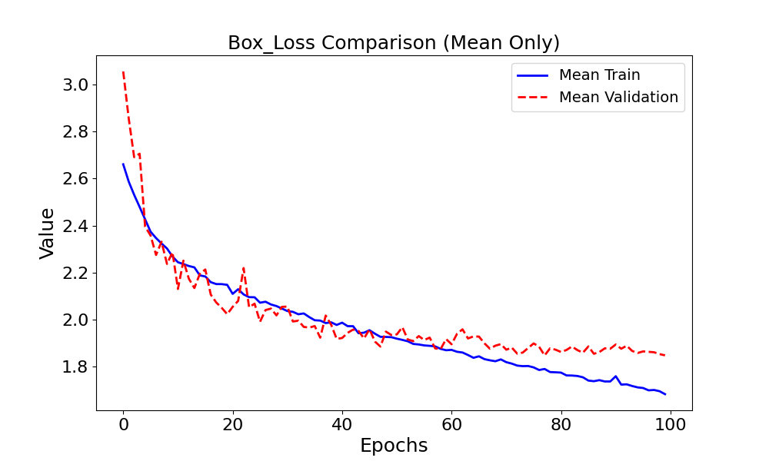
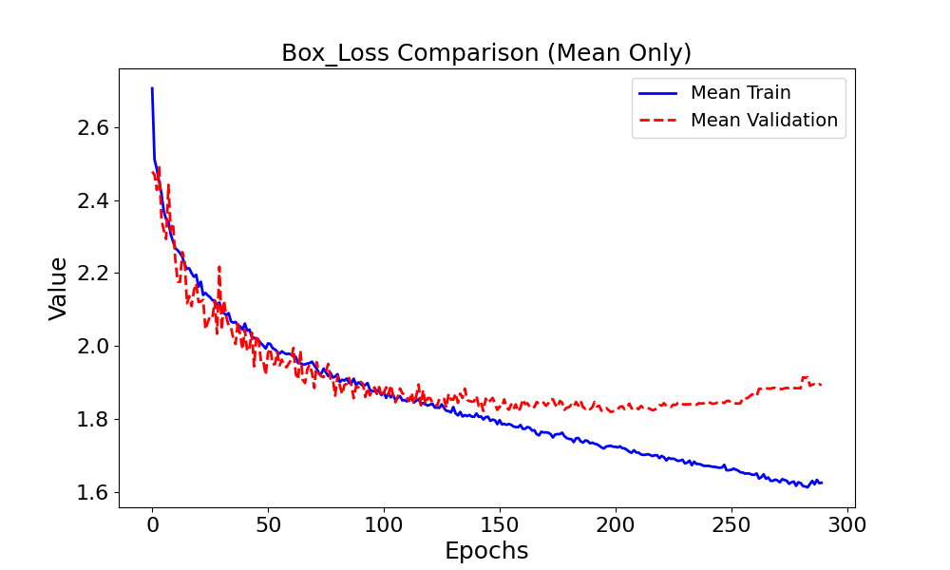
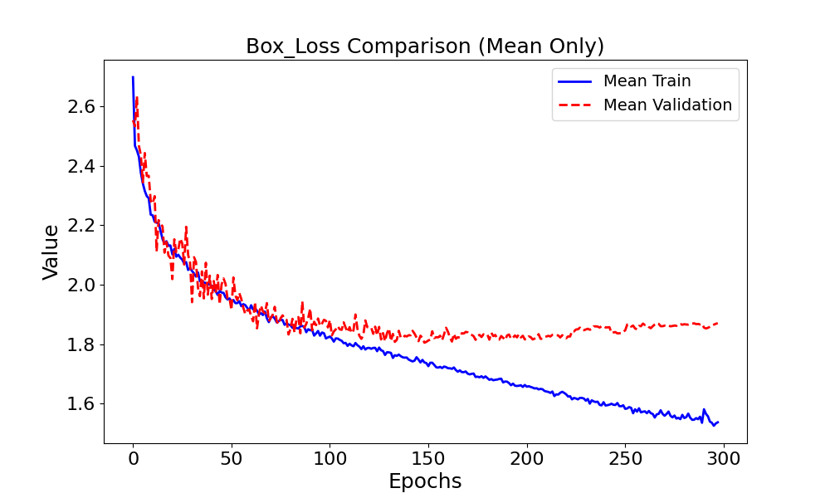
Box Loss
Large 100
Small 300
Small Aug

Slide 23
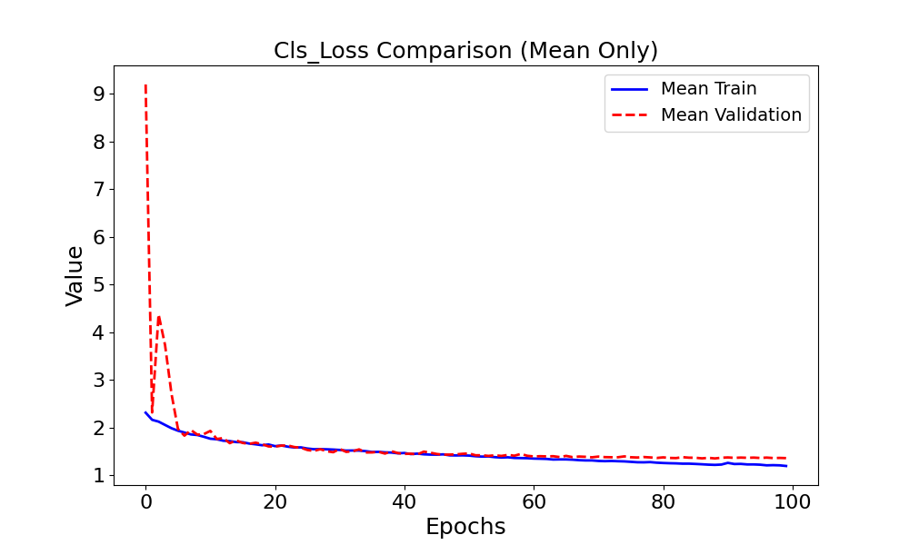
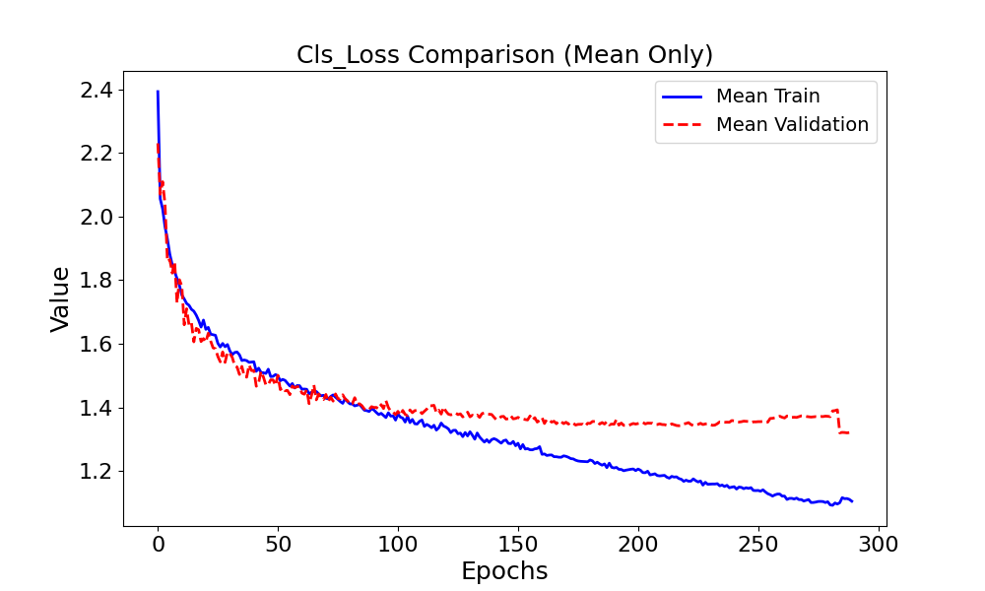
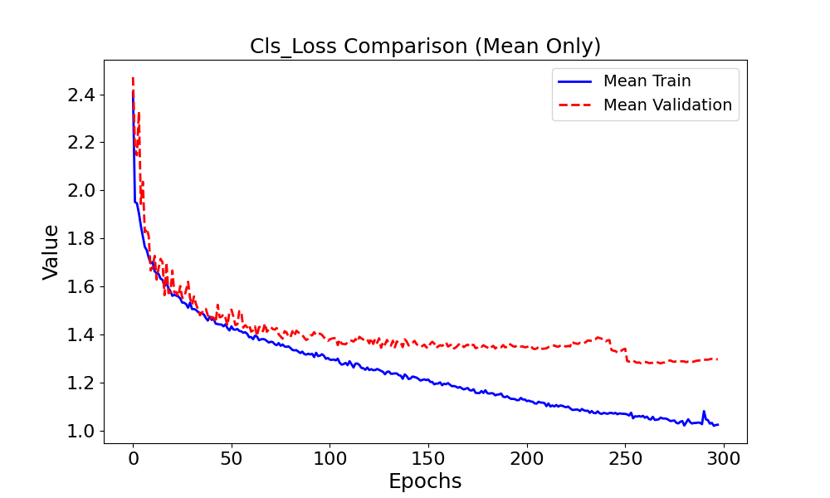
Class Loss
Large 100
Small 300
Small Aug

Slide 24
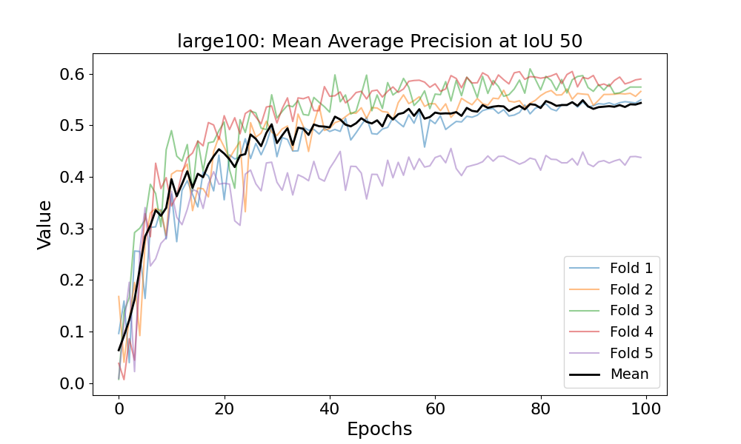
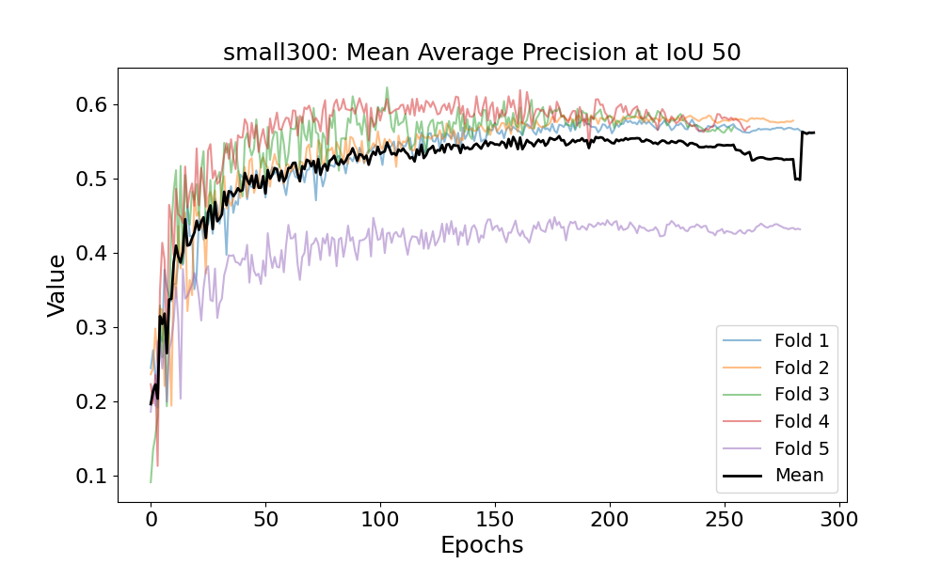
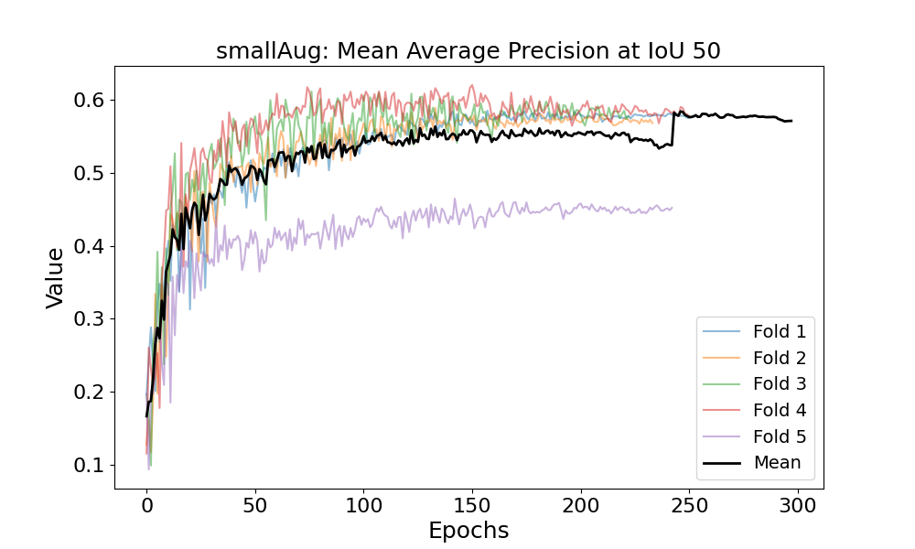
mAP50

Slide 25
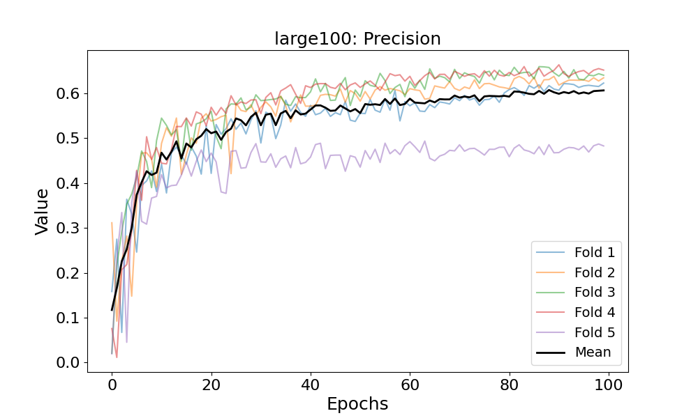
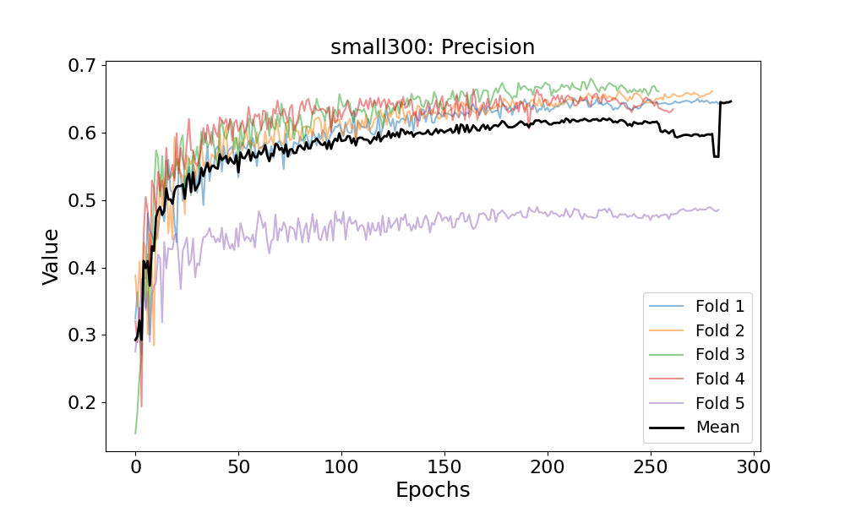
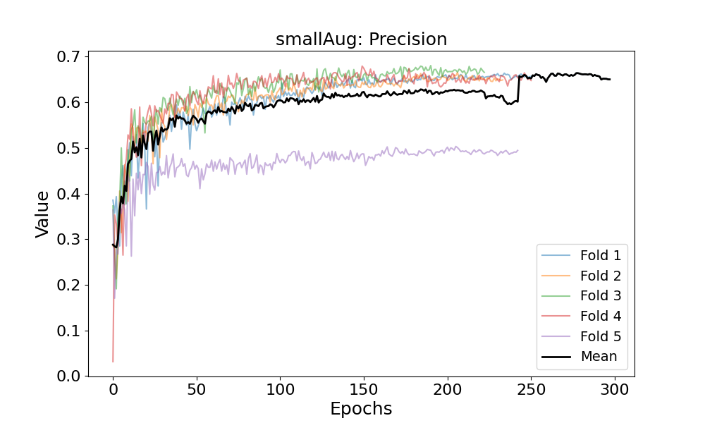
Precision

Slide 26
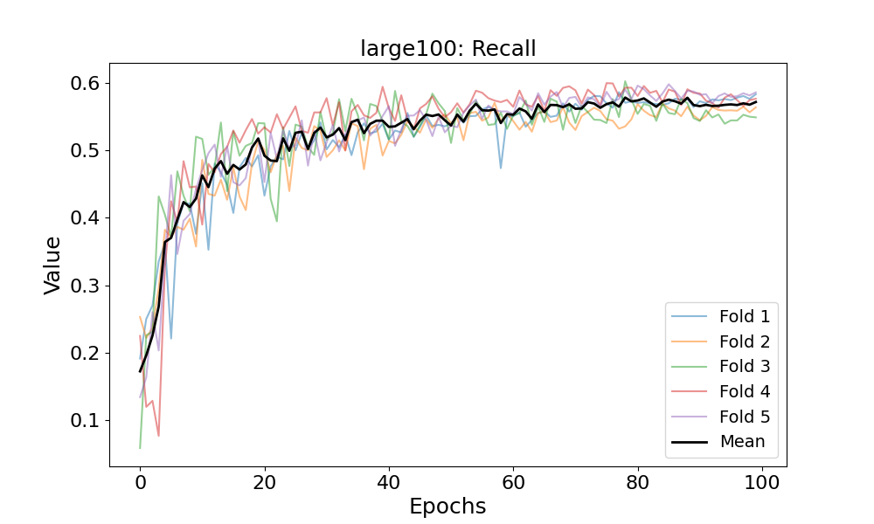
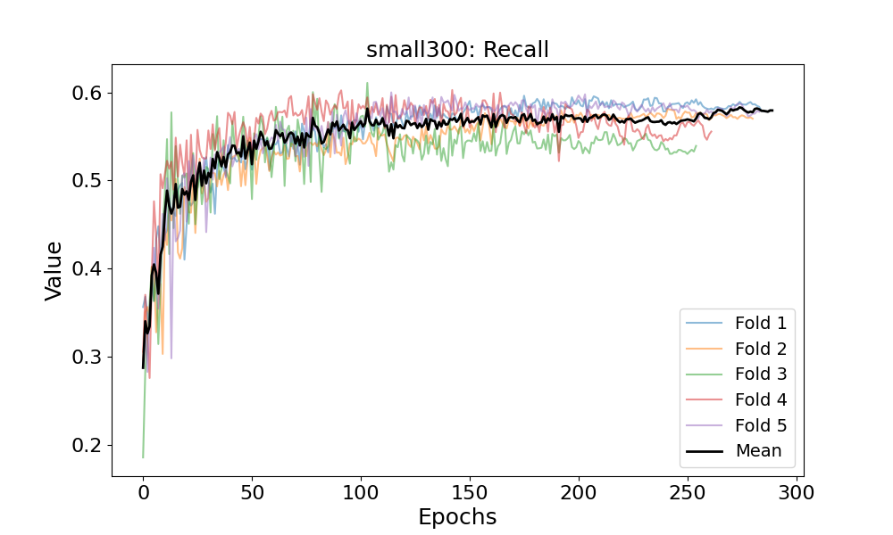
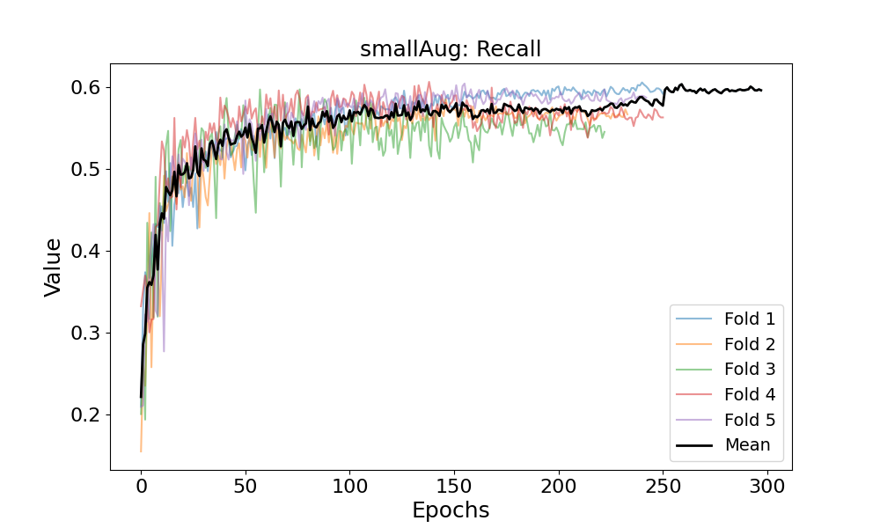
Recall

Slide 27
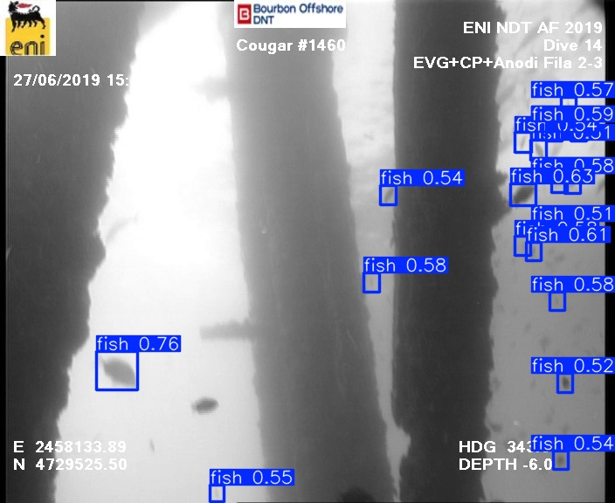
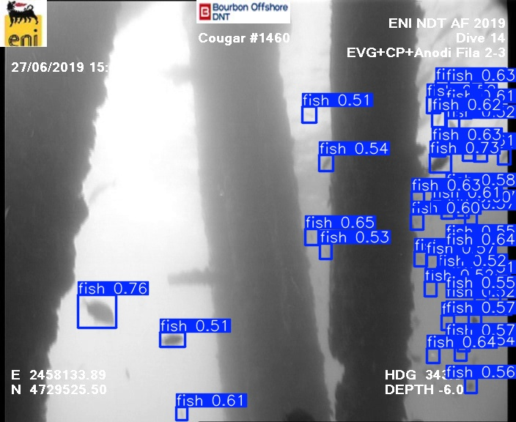
Inference 1: augmentation impact
Test frame 8, fold 4, threshold 0.5
Small 300
Small with Aug

Slide 28
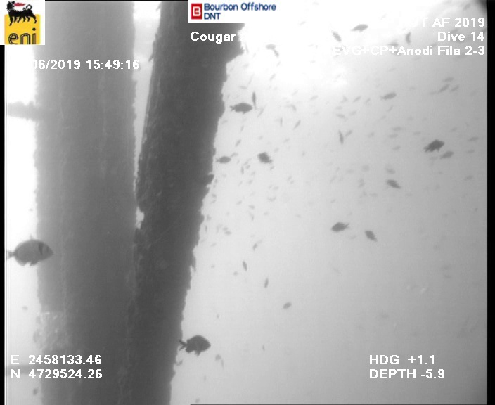
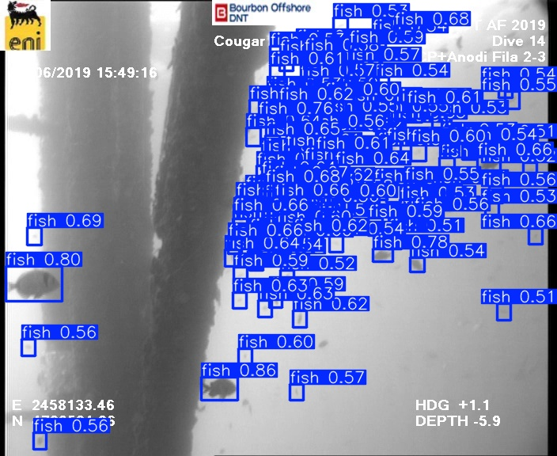
Inference 2: behaviour with shoals
Test frame 14, fold 5, threshold 0.5
Original
Small 300

Slide 29
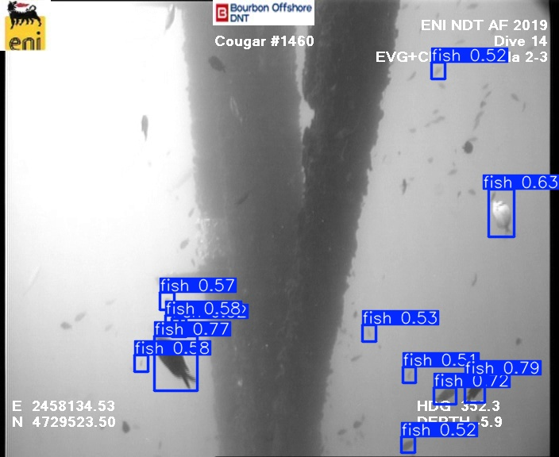
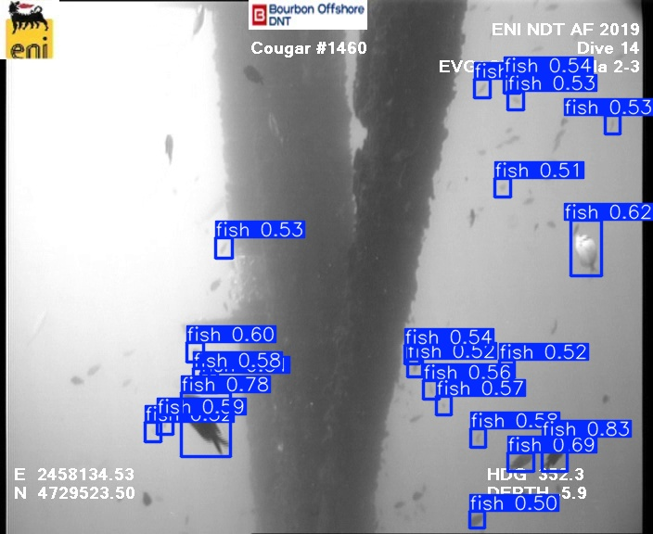
Inference 3: default best vs our epoch
Test frame 3, fold 3, small300, threshold 0.5
Best.pt
Our epoch.pt

Slide 30
06
Conclusions
Lessons learned and future work suggestions

Slide 31
Lessons learned
Data Quality significantly affects Model Performance
1
Preprocessing is important but must be careful to avoid introducing noise, particularly when using automatic labeling and manual adjustments.
2
Model Size vs. Efficiency Trade-offs
The YOLOv8 Large model was more accurate but needed more training time and resources. A Small model with augmented training was a balanced choice.
Targeted Data Augmentation improves detection
3
Augmentation strategies for underwater lighting, fish size and species variability improved the model's robustness despite dataset quality issues.

Slide 32



Future work suggestions
Improve annotation quality
Test new models
Advanced data augmentation
Test new models, like YOLOv11, for potential improvements in detection accuracy and efficiency
Tools like Roboflow can make the borders of objects more precise
Make experiments with additional augmentation types

Slide 33



Thanks!
Authors contact:
Federico Staffolani
s1114954@studenti.univpm.it
Enrico Maria Sardellini
s1120355@studenti.univpm.it
Scan QR code for Github repo!

